Slide 1
Agenda
Summary
Who was interviewed
What matters to our customers
Customer Satisfaction scores
Customer Loyalty (NPS)
Vision about future Business with us
Problem handling
Conclusions

Slide 2
Summary
CSI increased to 84.1%
Customer Satisfaction Index (CSI): 84.1%
This is up from 83.2% in 2016.
JW: 83.9% (2016: 83.1%) Tiflex: 85.9% (2016: 84.3%)
NPS is 49.6%
Net Promoter Score (NPS): 49.6%
25 topics
The highest Average is 8.9 for ‘Quality Assurance Regimes’.
20 out of 25 requirements achieved a score > 8.00.
There have been no drops in satisfaction since the 2016 survey.
Problem handling
21% of customers had a problem in the 12 months prior to being surveyed.
Average score for satisfaction with problem handling is 6.9.
Volume of business
180 contacts said their volume of business will ‘increase’ with us.
Take action!
Focus on Getting things right at first
Provide information on order delivery and keeping our ‘promises’
Improve the way problems are handled

Slide 3


Who was interviewed (1/2)
The survey was open from 22nd January to 23rd February.
487 customers were interviewed
28% of customers requested to remain anonymous
2016 survey: 495 interviews

Slide 4
Who was interviewed (2/2)

Slide 5
What matters to our customers? (1/3)
Satisfaction score is
lower than/higher than
importance rating
Sorted in descending importance order.
Notes:
By comparing customers’ requirements (importance ratings) with their perceptions of the organisation (satisfaction ratings) the areas where customers needs are being exceeded, met or failed can be identified.

Slide 6

What are the three most important criteria upon which you choose a supplier?
What matters to our customers? (2/3)

Slide 7
Satisfaction scores
What matters to our customers? (3/3)
Less satisfied/more satisfied
than 2016
Sorted in descending importance order.
Notes:
The slide shows the mean average score given for each satisfaction requirement and how it has changed since the survey was last carried out. It has been sorted in descending importance order.

Slide 8
Spread of satisfaction scores
Sorted in descending importance order.
Notes:
The chart shows the percentage of customers that gave each score on the one to ten scale where one is ‘completely dissatisfied’ and ten is ‘completely satisfied’.

Slide 9
Benchmarking James Walker against other B2B Manufacturing companies
The chart is sorted by James Walker’s distance from average.
= James Walker
Notes:
As well as the overall Customer Satisfaction Index™, TLF’s database can make comparisons at individual requirement level. Some requirements are industry specific and cannot be widely benchmarked. Other requirements such as ‘helpfulness’ apply to many customer-supplier relationships so can be widely benchmarked.

Slide 10
Benchmarking James Walker against the best scores for B2B Manufacturing companies
The chart is sorted by James Walker’s distance from best order.
Below best
The best
Notes:
As well as the overall Customer Satisfaction Index™, TLF’s database can make comparisons at individual requirement level. Some requirements are industry specific and cannot be widely benchmarked. Other requirements such as ‘helpfulness’ apply to many customer-supplier relationships so can be widely benchmarked.

Slide 11
Priorities for Improvement Tracking
‘Based on your most troublesome complaint’

Slide 12
Satisfaction targets
Overall TLF league table
1140 companies
B2B TLF league table
250 companies
85.2% to reach
top quartile
83.5% to reach
top quartile
2018: 84.1%
2018: 84.1%
2016: 83.2%
2013: 82.5%
2014: 81.8%
2012: 81.1%
2011: 79.5%

Slide 13
Satisfaction Index by Business Area
Decrease in Index/increase in Index
compared to 2016
These businesses would be in the top quartile of the TLF B2B league table.
Notes:
The purpose of this chart is to highlight the difference in the Satisfaction Index™ between customer groups and how this has changed since the survey was last carried out.

Slide 14
Satisfaction Index by Customer Type
Decrease in Index/increase in Index
compared to 2016
No data in 2016
Notes:
The purpose of this chart is to highlight the difference in the Satisfaction Index™ between customer groups and how this has changed since the survey was last carried out.

Slide 15
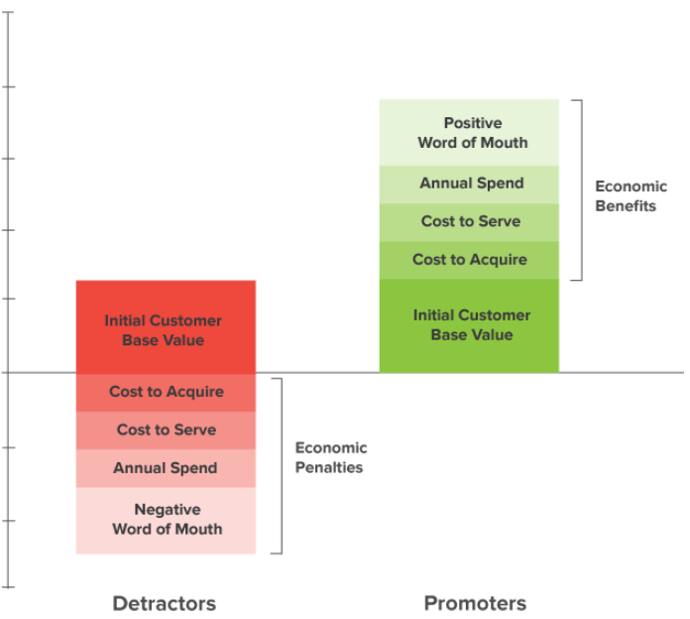
Net Promoter Score (NPS)
Based on your experience, how likely or unlike would you be to recommend James Walker to colleagues?
The NPS measures our customers’ loyalty over time
[ % Promoters minus % Detractors ]
The Promoters are likely to show value-creating behaviors:
buying more,
remaining customers for longer,
and making more positive referrals
to other potential customers.
The Detractors are showing the opposite behaviours.
Unlikely to recommend
Extremely likely to recommend
Detractors
Passives
Promoters
 |  | 1 | 2 | 3 | 4 | 5 | 6 | 7 | 8 | 9 | 10
Examples of NPS scores
Tesla 97%
Amazon 61%
Apple 55%
Samsung 45%
Mercedes 39%
Ikea 32%
Virgin Mobile 7%
Saint-Gobain 64%

Slide 16
Net Promoter Score (NPS)
Based on your experience, how likely or unlike would you be to recommend James Walker to colleagues?
Promoters
= 57.7%
Passives
= 34.2%
Detractors
= 8.1%
57,7% minus 8,1% = 49,6%
Remember Tesla’s score?
Notes:
The Satisfaction Index™ is an overall measure of an organisation’s success in satisfying its customers. It uses importance scores to weight satisfaction scores. A weighted average score for each customer is calculated and expressed as a percentage. It is statistically accurate.

Slide 17
Net Promoter Score league tables
The overall league table
680 companies.
The B2B manufacturing league table
145 companies
2018: 49.6%
2018: 49.6%
2016: 37%
2016: 37%
Notes:
The Satisfaction Index™ is an overall measure of an organisation’s success in satisfying its customers. It uses importance scores to weight satisfaction scores. A weighted average score for each customer is calculated and expressed as a percentage. It is statistically accurate.

Slide 18
Net Promoter Score by Business Classification & Area
Notes:
The purpose of this chart is to highlight the difference in the Satisfaction Index™ between customer groups and how this has changed since the survey was last carried out.

Slide 19
Level of Business

Slide 20
Over the next 3 years, would you expect the level of business you have with James Walker will:
Index: 85.1%
NPS: 60.0%
% had a problem: 23.9%
Handling of problems: 7.8
Index: 84.1%
NPS: 44.1%
% had a problem: 14.4%
Handling of problems: 6.3
Index: 74.9%
NPS: 29.4%
% had a problem: 35.3%
Handling of problems: 3.8

Slide 21
Level of business by Business Area
Over the next 3 years, would you expect the level of business you have with James Walker will:

Slide 22
Problem Handling

Slide 23





Problem handling
21% of customers have had a problem in the last 12 months:
62%
had 1 problem
38%
had more than 1 problem
Top 3 problems:
If the customer had experienced more than one problem, they were asked about their ‘most trouble-some’ problem.
Product quality & conformity
Deliveries (not on time and/or not in full)
Communication
Average score:
6.9 / 10
Notes:
The way in which a business responds to problems or complaints experienced by its customers can often have a major effect on customer satisfaction and through word of mouth (either positive and negative) this effect can spread far wider than the customer who initially experienced the problem.
Here we focus on the results of questions included in the survey to enable investigation of the problem handling process.

Slide 24
Problem handling:
Opportunities and Threats

Slide 25
Problem handling
Through the lens of MyCase
Duration and Customer Satisfaction

Slide 26
Problem handling
Through the lens of MyCase
Root Causes and Severity

Slide 27
Customer Experience
Through the eyes of our customer-facing teams
Our ISRs, FRs and managers were asked to explain:
their best experience with a customer
and
⇨ their most frustrating experience with a customer
62% responded (153 out of 248)
-5
+13
+10
+25
-36

Slide 28
Our customers’ journey map
Givens
Steps in the customer's journey with your company

Slide 29
Priorities for Improvement
Considerations
Key Recommendations
Order information
What exactly are customers told when they place an order?
How quickly are they given this information?
How accurate is it?
Delivery information
At what stage do you realise an order (or part order) will be later?
Do you tell the customer?
When and What exactly do you tell the customer?
Proactivity
Do you have ways to help customers if the later/partial delivery is going to be a problem?
Who, at customer end, do you talk to about this ?
Problems and complaints
Anticipate problems and deal with them as quickly as possible before they escalate.
Give bad news quickly… or the situation will escalate
Making improvements
If your system isn’t working… what is the blockage? Is it internal communication? Is it a process or system failure?
Who has the answers?
Involve staff in coming up with action plans.
Focus on complaint handling
Eradicate root cause
Common problems are around deliveries, product quality and communication.
Misinformation or no information is causing issues.
Lack of communication is even worse,
Keep your promises
Keep your customers informed effectively
Problem handling is not as consistent as it needs to be
Ensure the use of MyCase
Monitor the effectiveness of complaint handling?
Get Things right first
Prevent reoccurrence

Slide 30
And when it goes to plan…
I expect that the level of business with James Walker & Company will increase because we have found a way of working successfully with James Walker.
I haven't had any issues with them, when I phone them they always come back, the buyer sends request for quote and if they don't understand they phone or email for clarity so that things get addressed before there is an issue.
They make my job easy, and I have to say there's never a problem with the product, I've never had to go them in 20 years and say there's a bad batch, we've never had a recall.
They were very helpful, they were very responsive, they actively reached out we had discussions. Overall they were helping us out with the problem we had and getting parts delivered.
The staff responded to all our queries and questions. They gave us feedback and everything was all on time. The delivery times were clear.
We occasionally have issues but they always resolve it, they are very good at getting me out of the fire when something has gone wrong. They do react very well they are very open with us, contact is really easy they help us out whenever they can and if the person I speak to doesn't know the answer they will find it out and contact me back.
Whatever requests we have had they have been very helpful and very proactive in their approach. The way they deal with us, we are very happy. The way they communicate with us and sort things out.

Slide 31
Any question?

